Slide 1


Cifar-10 Classification
Cifar-10 Classification with Keras Tuner
Alessandro Kuz
Monday 23/10/2023

Slide 2

Dataset overview
Index
Model Timeline
Results achieved
Conclusions
Resources and links

Slide 3

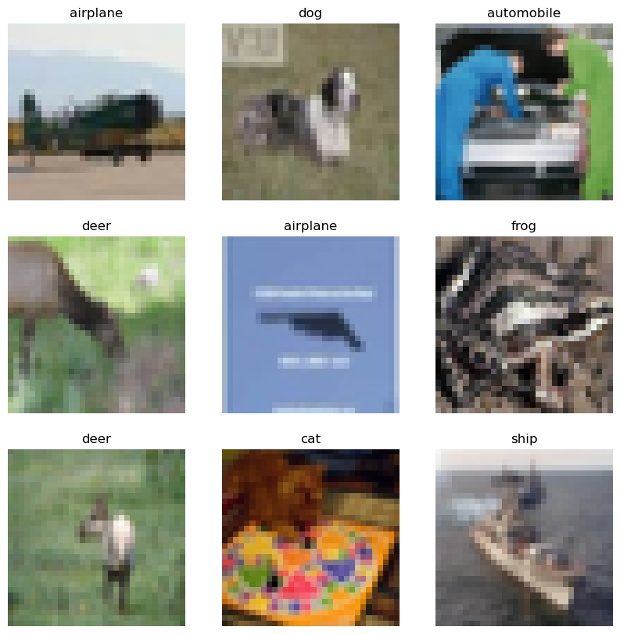
Cifar-10 Classification
Dataset overview
60.000 Images, equally split in 10 Classes
Image size: 32x32x3
Type: numpy Array - tf.data.Dataset
Classes: Airplane, Automobile, Bird, Cat, Deer, Dog, Frog, Horse, Ship, Truck
Back to index

Slide 4
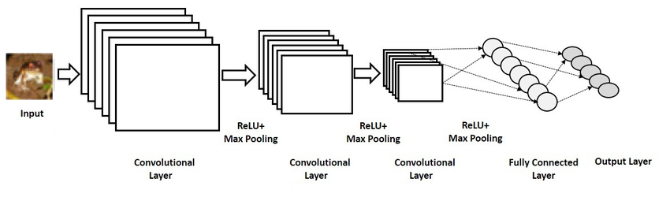

Models Timeline
The model uses a Convolution atchitecture, followed by a MLP;
Hyperband tuner
1st Model
2nd Model
3rd Model
Tuned Model
Multiple parameters tuned:
kernels, neurons, regularizers, dropout...
Second re-run, to verify optimal parameters, model architecture overview
Reduced parameters to optimal ones; only regularizers tuned
Final Training of the model, accuracy evaluation, review of previous work
Back to index

Slide 5
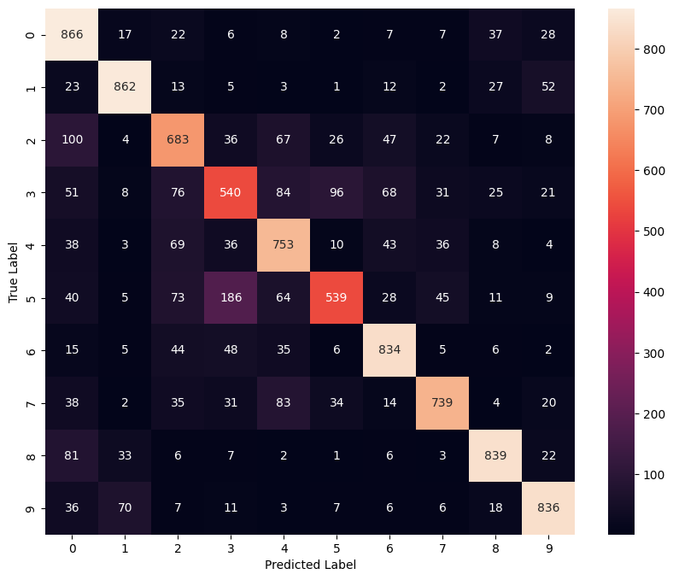

Results achieved
Highest Accuracy: 0.75 on Validation set
Pros:
Helped to achieve higher accuracy
Good for choosing regularization parameters
Cons:
Slowes down model building and deployment
Occasionally similar perfomances of known architectures
Back to index

Slide 6


Conclusions
Hypertuning for big projects and slightly better performance
Perfomance / cost trade-off
Alternatives for improvents
Back to index

Slide 7

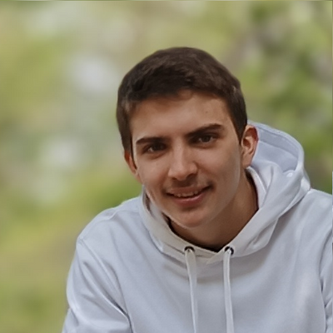

Resources
Cifar-10 Dataset:
https://www.cs.toronto.edu/~kriz/cifar.html
Contacts & Info
Tensorflow tutorials::
https://www.tensorflow.org/tutorials
Alessandro Kuz
Contacts & Links:
LinkedIn: https://linkedin.com/in/alessandrokuz
Kaggle: https://www.kaggle.com/alessandrokuz
GitHub: https://github.com/AlessandroKuz
Hyperband tuner:
https://arxiv.org/abs/1603.06560
Back to index

